Slide 1
Changing IP in changing Europe Panel session on Protection of AI-related technical creations: including IoT and Software-Based Patent Protection (with reference to the recent EPO guidelines)

Slide 2
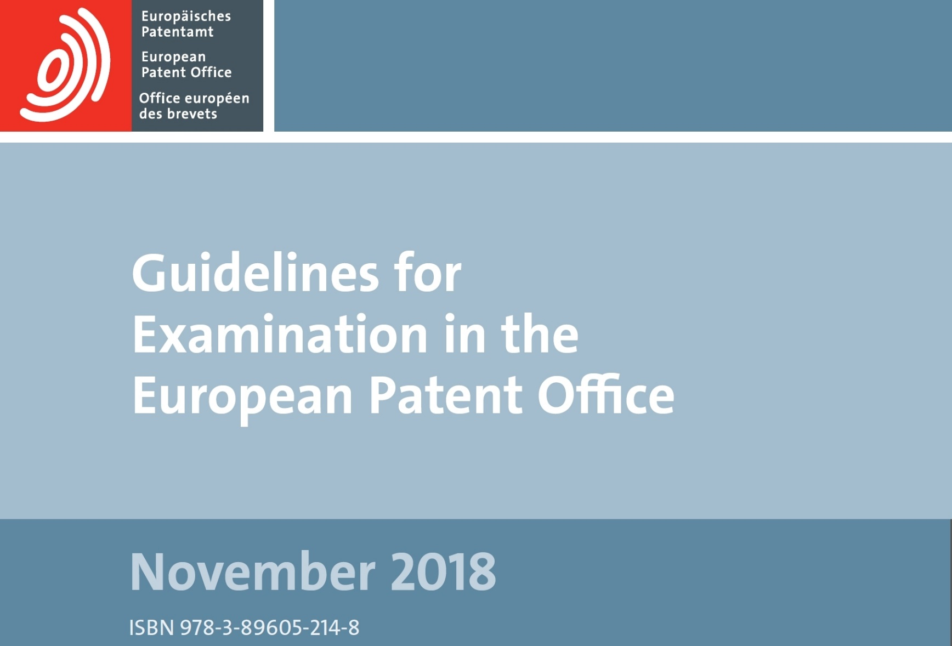
AI specific guidelines: G-II, 3.3.1

Slide 3
AI specific guidelines: G-II, 3.3.1
Artificial intelligence and machine learning
Artificial intelligence and machine learning are based on computational models and algorithms for classification, clustering, regression and dimensionality reduction, such as neural networks, genetic algorithms, support vector machines, k-means, kernel regression and discriminant analysis. Such computational models and algorithms are per se of an abstract mathematical nature, irrespective of whether they can be "trained" based on training data.
…
Where a classification method serves a technical purpose, the steps of generating the training set and training the classifier may also contribute to the technical character of the invention if they support achieving that technical purpose

Slide 4
AI specific guidelines: G-II, 3.3.1
Excluded from patentability
computational models and algorithms such as neural networks, etc.
Potentially patentable (if it serves a technical purpose)
Method for classification, etc.
Method for training a classifier
Method for generating a training set
What exactly is the EPO talking about?

Slide 5
Learnt vs non-learnt (1)
Technical model defined by a human (function f)
Input x
Output y
Function f is set by a human (for instance knowing laws of physics/biology, etc.) and implemented
f is applied to input x so as to calculate corresponding output y=f(x)

Slide 6
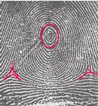
Learnt vs non-learnt (2)
First example of fingerprint processing
x is a fingerprint image
y is a person identity
Function f=
identifying specific features of of fingerprint ridges, called minutiae
attempting to match identified minutiae with that of known fingerprints associated with identities
Confirmation of identity if number of matched minutiae is above a threshold

Slide 7
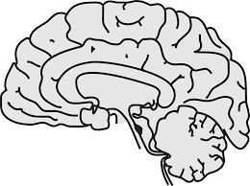
Learnt vs non-learnt (3)
Computational model learnt by a machine (function $\tilde{f}$)
Input x
Output y
Training set ${\left\{(xi,yi)\right\}}_{i∈⟦1;n⟧}$

Slide 8
Learnt vs non-learnt (4)
A training set of couples (x_{i}, y_{i}) is known
A machine-learning algorithm A is applied to the training set so as to learn a function $\tilde{f}$ approximating the theoretical function f such that $∀i,\text{y}\text{i}\text{=}\text{f}\text{(}\text{x}\text{i}$)
$\tilde{f}$ is applied to input x so as to calculate corresponding output y=$\tilde{f}$(x)
Note that $\tilde{f}$ is a « black-box »!

Slide 9
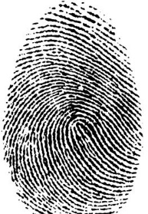
Learnt vs non-learnt (5)
Second example of fingerprint processing
(x_{i}, y_{i}) are couples of fingerprint images/identities
$\tilde{f}$ is a Convolutional Neural Network trained using a suitable algorithm A

Slide 10
What could be patentable?
$\tilde{f}$ is the « computational model »
Non patentable as such
Sufficiency of disclosure unlikely to be met
The use of $\tilde{f}$ for identity determination is a « method for classification »
Potentially patentable
The use of algorithm A for obtaining $\tilde{f}$ is the « method for training a classifier »
Potentially patentable
A method that would help in adding more couples (x_{i}, y_{i}) to the training set
potentially patentable

Slide 11
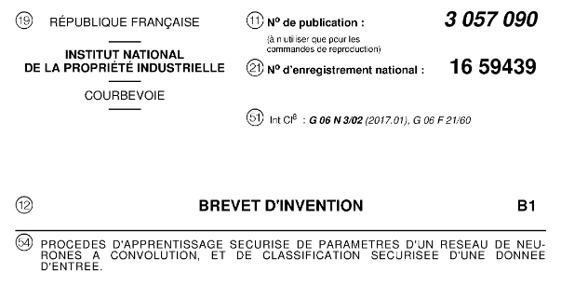
Example

Slide 12
Example
Technical problem:
Privacy (training set or input data are often confidential)
Solution:
A new structure of neural network which is fully compatible for homomorphic encryption
Technical effect:
This new neural network can work with encrypted data and thus privacy is guaranteed
Such invention serves a technical purpose

Slide 13
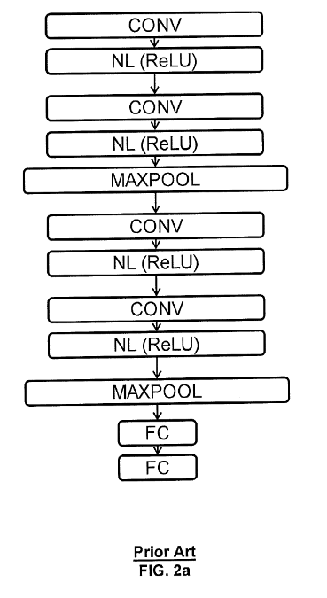
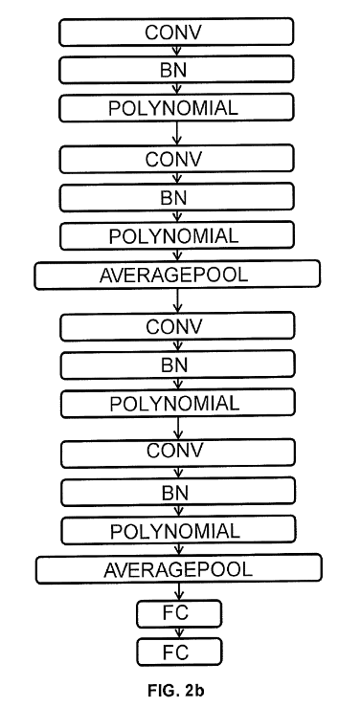
Example

Slide 14
Example
The new structure of neural network is a non patentable computational model !
But…
Claim 1: A method for secure learning of parameters of a convolution neural network, CNN, for data classification, the method comprising ...
➔ method for training a classifier
Claim 6: A method for secure input data classification, comprising ...
➔ method for classification

Slide 15
Thank you for your attention
Matthieu Objois
French & European Patent Attorney
objois@regimbeau.eu
www.regimbeau.eu

